Slide 1
IBM HR Analytics Employee Attrition & Performance
By Mohit Lokhande

Slide 2
Project Curriculum
The company wants to understand what factors contributed most to employee turnover and to create a model that can predict if a certain employee will leave the company or not. The goal is to create or improve different retention strategies on targeted employees. Overall, the implementation of this model will allow management to create better decision-making actions

Slide 3
Problem Statement
Why Employees Are Leaving The Company
Employees looking for better opportunities.
A negative working environment.
Bad management
Sickness of an employee (or even death)
Excessive working hours

Slide 4
Data Set
There are 1470 observations and 35 Features.
No missing values.
Data type:
^ Numeric variables
^ Categorical variables

Slide 5
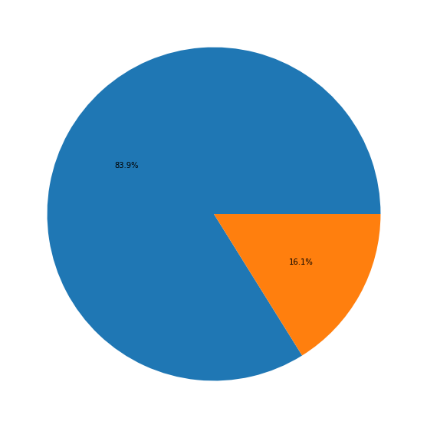
Attrition Rate
84% of employees stayed
16% churned
That is 237 out of 1470 employees churned

Slide 6
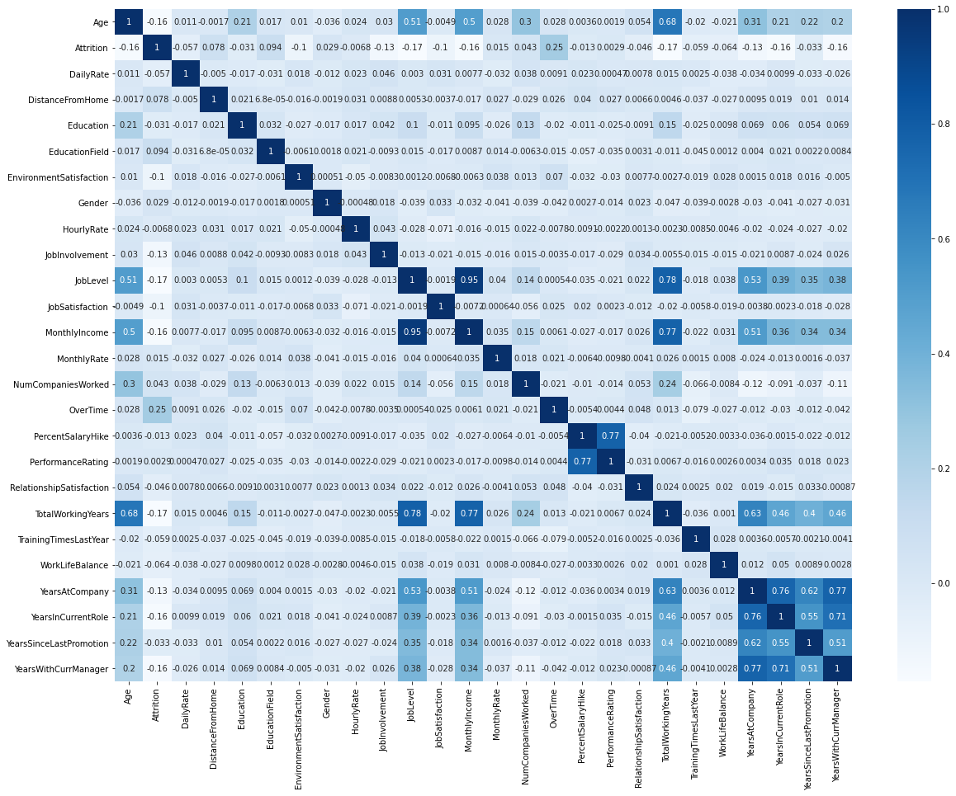
Correlation Between Features

Slide 7
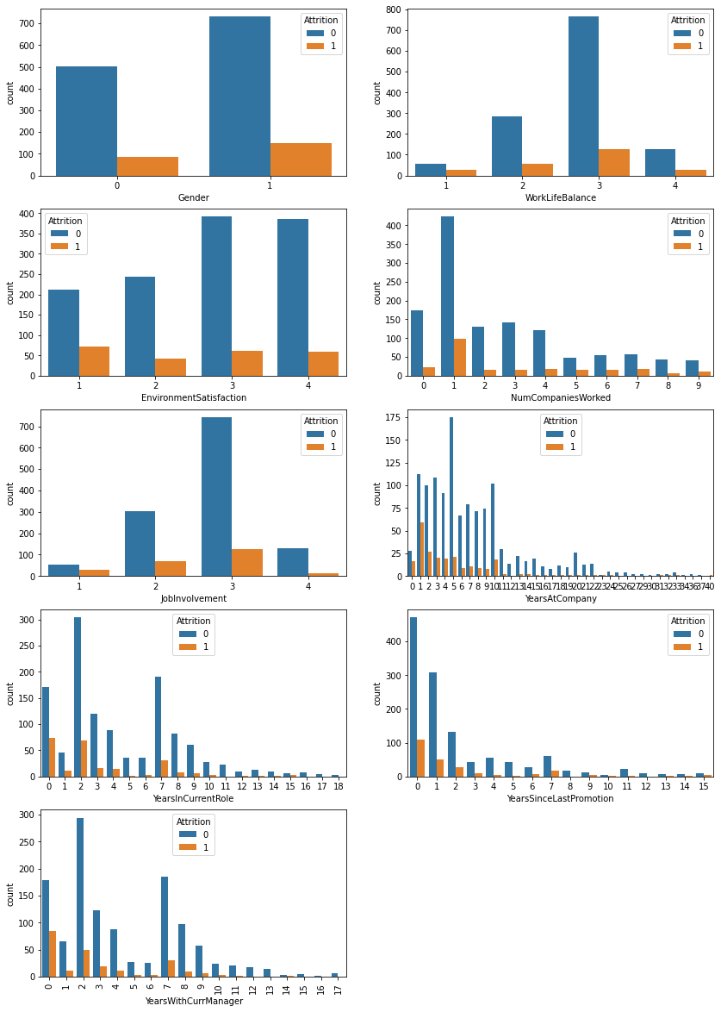
Job Roles by Various Categories
Men churned sooner than women
2. The environment in company churned to leave company sooner than others
3. Offers from another companies churned to switch again!
4. Employee lastly involves in Job in company tends to leave company sooner than others
5 . Seniors in company tends to leave sooner than others.
6. Current role for longer time and who just got new role tends to leave company sooner than others.
7. Those Employees Who gets no promotion for long time to leave company.
8. Employee who stay Manager for longer time and shorter time tends to leave company than other employees.

Slide 8
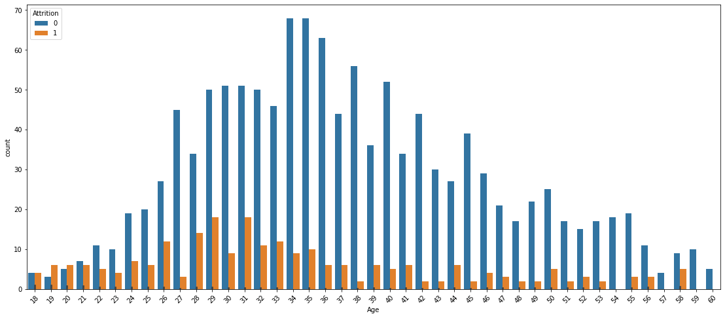
Attrition by Age
Using seaborn age distribution & Attrition is Age distributed quite normally and Employee who churn are younger.
Teenagers highly tends to leave company than Mid aged.
Persons whose age more than 55 tends to leave company than Mid aged.

Slide 9
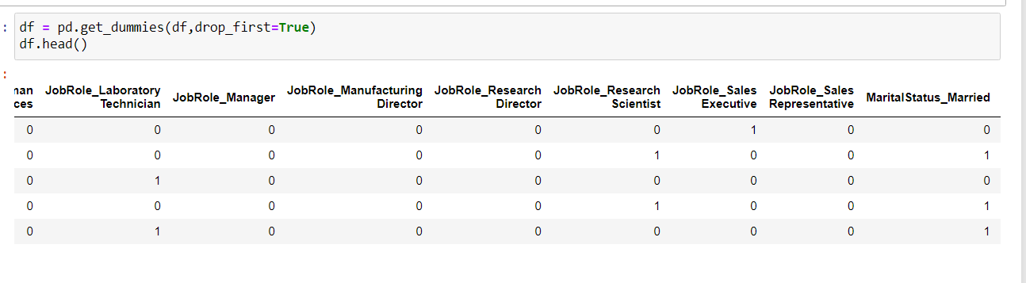
Dummy Variables: The get dummies() function is used to convert categorical variable into dummy/indicator variables.

Slide 10
Model Evolution
1. Logistic Regression: It is used to predicting the categorical dependent variable using a given set of independent variables. It predicts the output of categorical dependent variable.
Accuracy with Logistic Regression: 83.67
2. DecisionTreeClassifier:. Decision Tree is to create a training model that can be used to predict the class or value of the target variable by learning simple decision rules inferred from prior data (training data)
Accuracy with DecisionTreeClassifier : 76.33

Slide 11
Random Forest Classification: Random Forest is a classifier that contains a number of decision trees on various subsets of the given dataset and takes the average to improve the predictive accuracy of that dataset.
Accuracy with Random Forest Classifier : 83.67
Adaptive Boosting Classifier: One way for a new predictor to correct its predecessor is to pay a bit more attention to the training instances that the predecessor underfitted. This results in new predictors focusing more and more on the hard cases. This is the technique used by Ada-Boost.
Accuracy Score with Ada Boost Classifier : 85.5

Slide 12
Conclusion
Ada Boost Classifier performed well on this problem

Slide 13
Thank you

